Slide 1



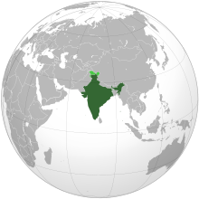


INDIAN CONSTITUTION

Slide 2
Lok Sabha Speaker [Article 93 - 96]
The presiding officer of the lower house of the Parliament is the Lok Sabha Speaker.
Provisions of his/her and deputy speaker’s offices are dealt with Articles 93, 94, 95 and 96 of the Indian Constitution.
In the Indian parliamentary democracy, the Office of the Speaker of Lok Sabha holds a significant position.
Speaker of Lok Sabha 2021 is – Om Birla
Deputy Speaker of Lok Sabha 2021 is – It is vacant (from 2019); Munisamy Thambidurai (2014 -19)

Slide 3
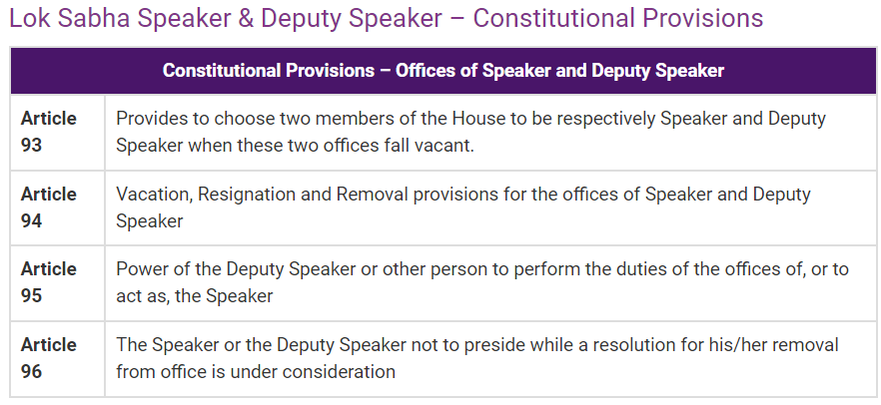

Slide 4
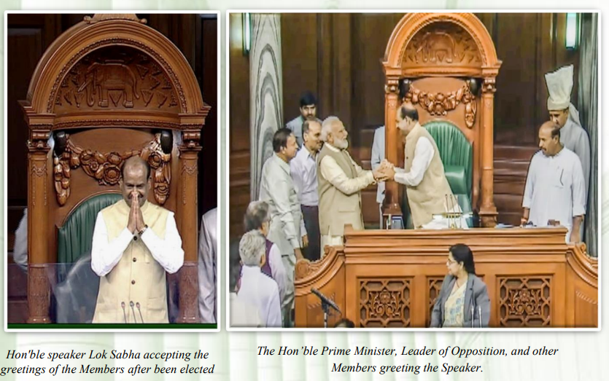
Lok sabha speaker

Slide 5
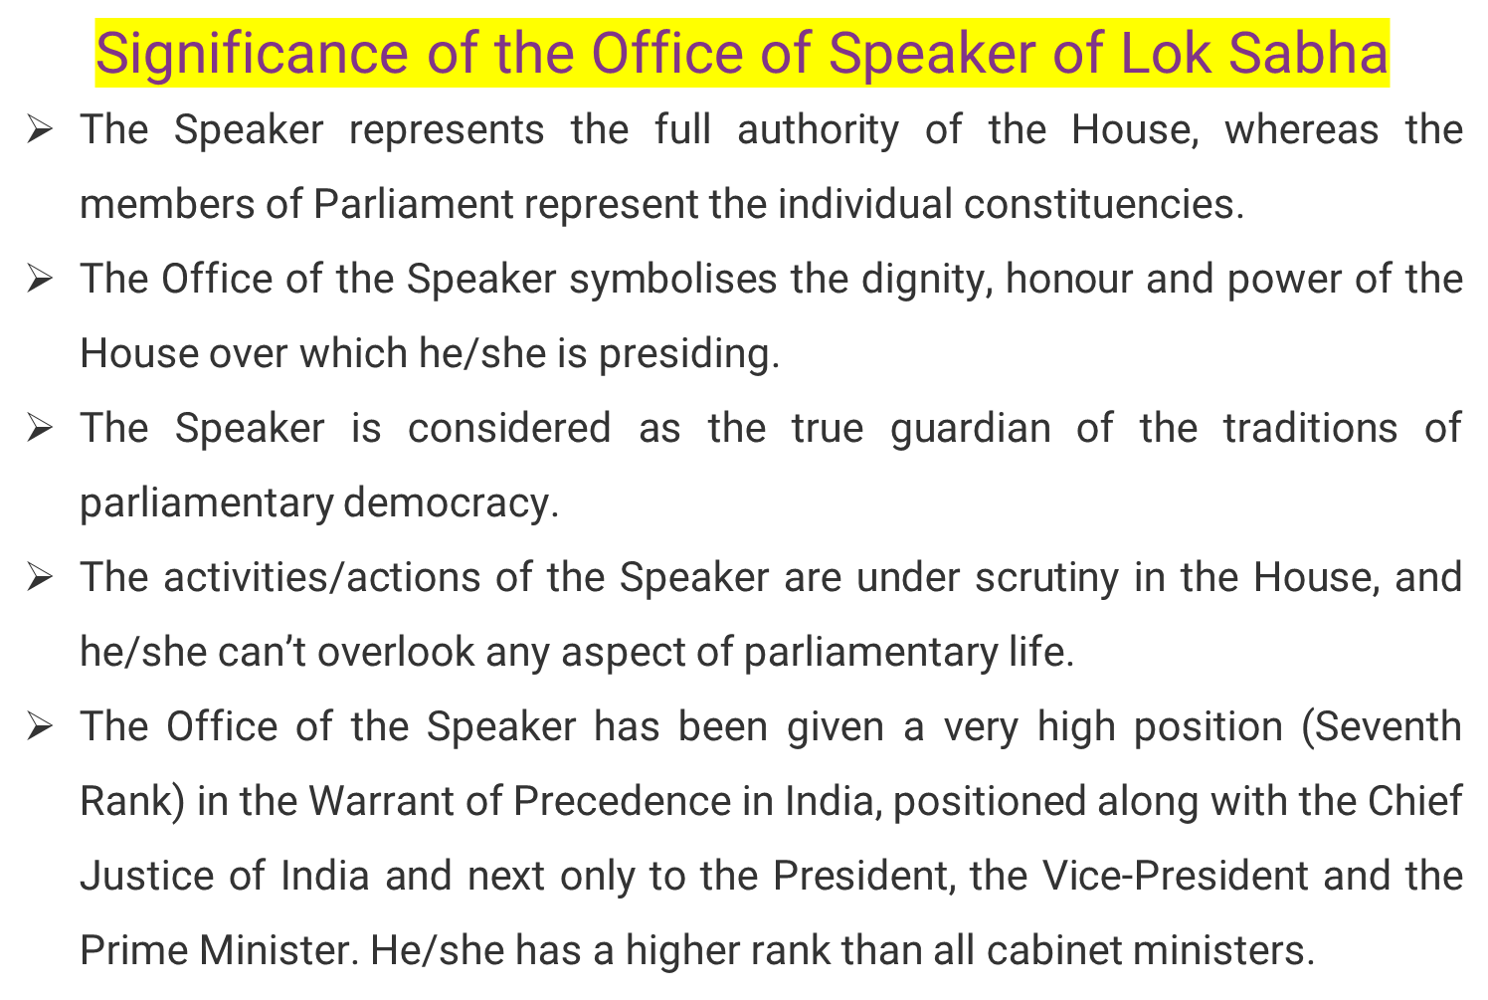

Slide 6

The date of election of the Speaker is fixed by the President.
As soon as after the first sitting of the Lok Sabha, the Speaker is elected by the House from amongst its members.
Whenever the office of the Speaker falls vacant, the lower House elects another member to fill the vacancy.
Election criteria –
  Simple majority of members present and voting in the House.
  No specific qualifications required.
Usually, a member belonging to the ruling party is elected the Speaker.

Slide 7

The Speaker is the head of the Lok Sabha.
He/she is the principal spokesperson of the House, and his decision in all Parliamentary matters is final.
The Speaker of the Lok Sabha derives his/her power from three sources:
  The Constitution of India
  The Rules of Procedure and Conduct of Business of Lok Sabha
  Parliamentary Conventions
The primary responsibility of the Speaker is to maintain order and decorum in the House for conducting its business and regulating its proceedings. He/she has final power in this matter.
He/she is the final interpreter of the provisions of
  The Constitution of India
  The Rules of Procedure and Conduct of Business of Lok Sabha
  Parliamentary precedents
He/she can adjourn the proceedings of the House or suspends the meeting in absence of a quorum.

Slide 8

The Speaker appoints the chairman of all Parliamentary Committees of the Lok Sabha.
He/she supervises the functioning of the committees and takes care of procedural problems, if any.
Speaker is the chairman of the following committees:
  Business Advisory Committee,
  General Purposes Committee,
  Rules Committee.

Slide 9

The Deputy Speaker is not subordinate to the Speaker.
He/she is directly responsible to the House.

Slide 10

Election criteria –
  Simple majority of members present and voting in the House.
  No specific qualifications are required.
Similar to the election of Speaker, the Deputy Speaker is also elected by the Lok Sabha itself from amongst its members.
He/she is elected after the election of the Speaker.
The date of election of the Deputy Speaker is fixed by the Speaker.
While assuming the office of the Deputy Speaker, he/she do not make and subscribe any separate oath or affirmation.

Slide 11

He/she performs the duties of the Speaker’s office when it is vacant.
He/she acts as the Speaker when the latter is absent from the sitting of the House.
In the above two case, the Deputy Speaker assumes all the responsibilities and powers of the Speaker.
In case the Speaker is absent, the Deputy Speaker can also preside over the joint sitting of the Houses of Parliament.

Slide 12
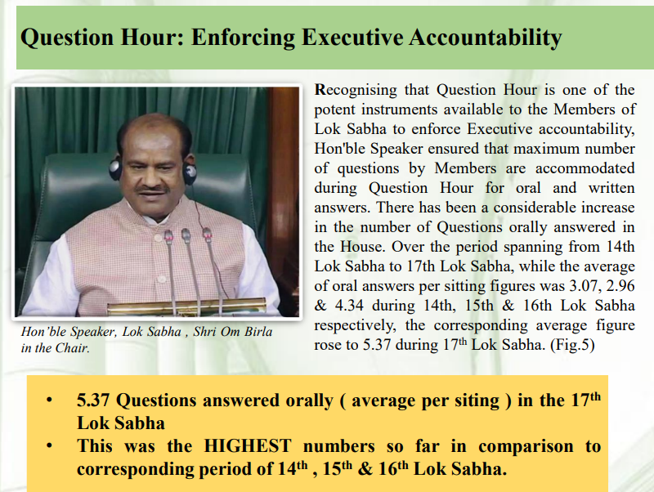

Slide 13
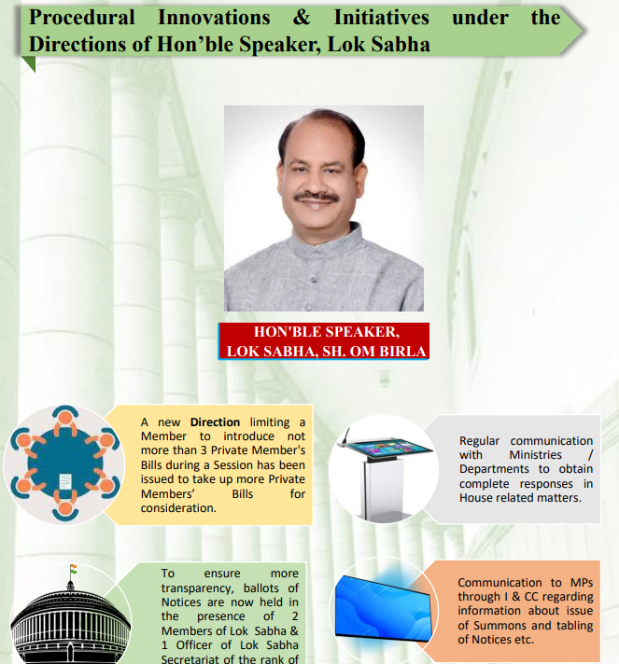

Slide 14
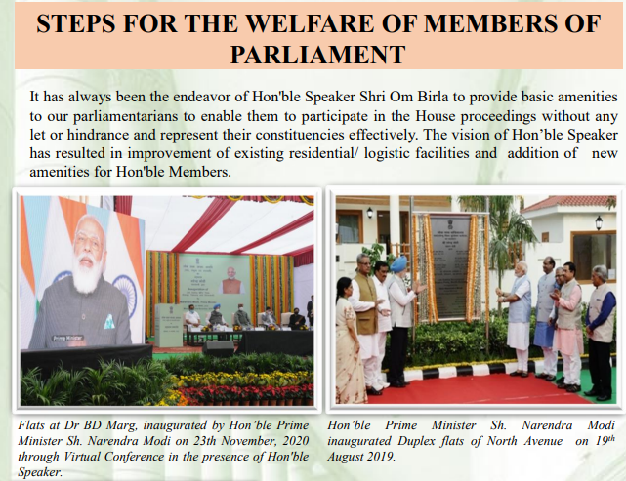

Slide 15
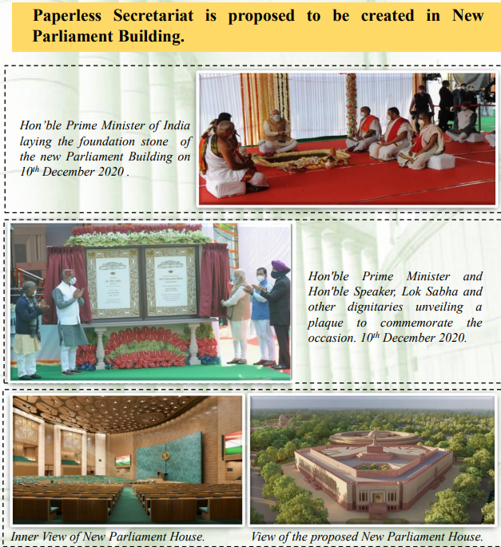

Slide 16
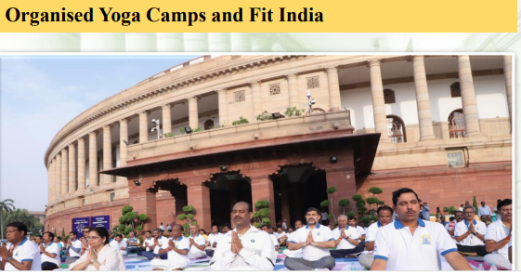

Slide 17
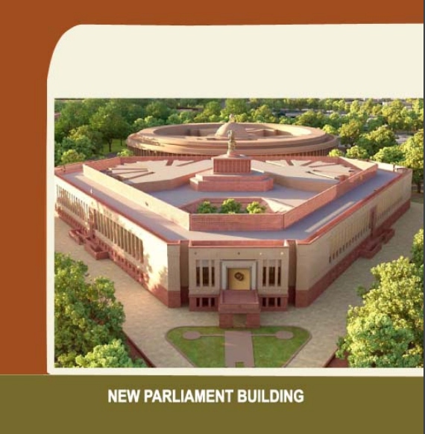

Slide 18
-THANK YOU-

